Slide 1
Lecture Counting Principles
Multiplication Rule
Permutation
Combination

Slide 2


How many ways?
There are 4 different ways to travel from town A to town B, 3 different ways to travel from town B to town C. How many total ways to travel from town A to town C via town B?

Slide 3
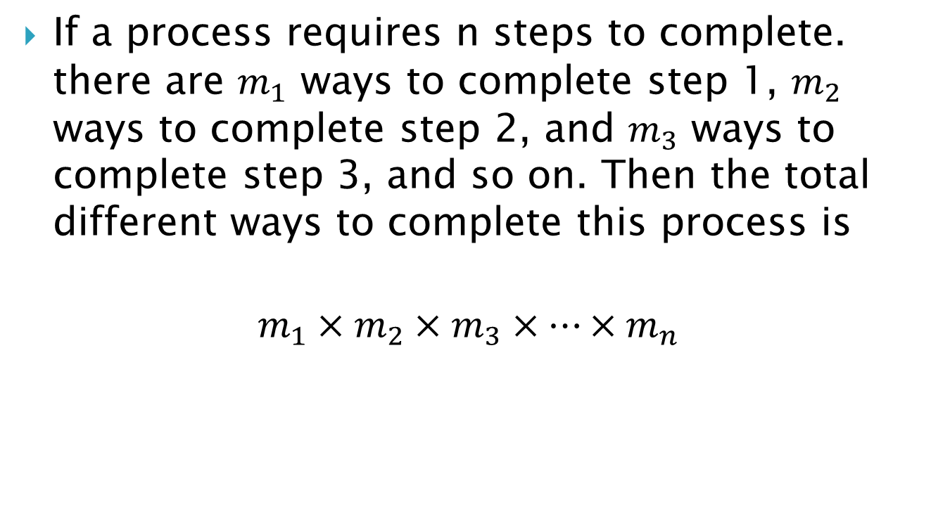
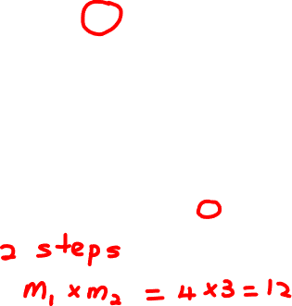
Multiplication Rule
If a process requires n steps to complete. there are $m_{1}$ ways to complete step 1, $m_{2}$ ways to complete step 2, and $m_{3}$ ways to complete step 3, and so on. Then the total different ways to complete this process is
$$m_{1}×m_{2}×m_{3}×…×m_{n}$$

Slide 4
Example:
5 digits 4, 7, 3, 2, 0 are to be arrange to form a five-digit number.
How many five-digit numbers can be form?
How many even number can be form?
How many even number greater than 40,000 can be form?

Slide 5
Example
5 digits 4, 7, 3, 2, 0 are to be arrange to form a five-digit number.
How many five-digit numbers can be form?

Slide 6
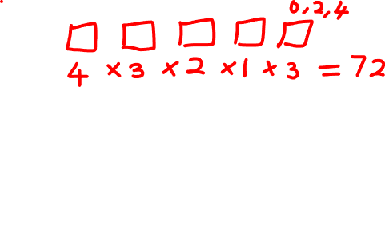
Example
5 digits 4, 7, 3, 2, 0 are to be arrange to form a five-digit number.
How many even number can be form?

Slide 7
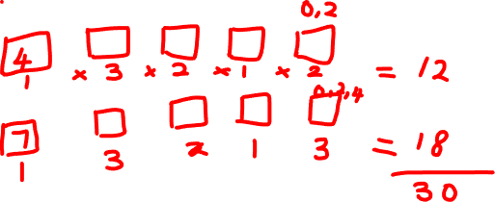
Example
5 digits 4, 7, 3, 2, 0 are to be arrange to form a five-digit number.
How many even number greater than 40,000 can be form?

Slide 8

Factorial
$n!=n×\left(n−1\right)×\left(n−2\right)×…×2×1$
Example: $8!=8×7×6×5×4×3×2×1$ $4!=4×3×2×1$ $\text{0!}\text{ = 1}$

Slide 9
Permutation and Combination
Three letters A, B, C are selected.
In how many different ways can these letters be arranged?
In how many different ways can these letters be grouped?

Slide 10

Permutation
To find the number of different ways to arrange $r$ objects from $n$ objects.
$${{}_{}^{n}P}_{r}=\frac{n!}{\left(n−r\right)!}$$

Slide 11
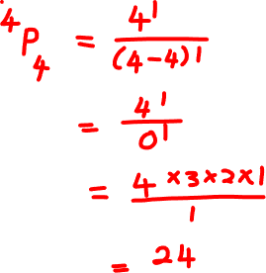
Example:
In how many ways can four students be seated in a row of four seats?

Slide 12
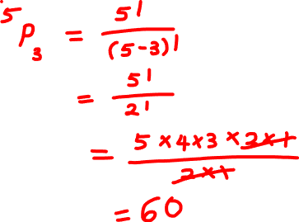
Example
How many ways can the first 3 places be awarded in a race involving 5 contestants (excluding ties)?

Slide 13
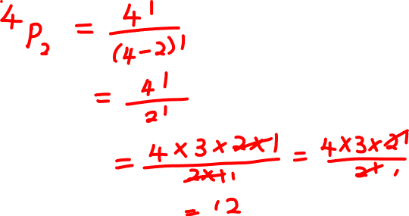
Example
How many 2 digit numbers can you make using the digits 1, 2, 3 and 4 without repeating the digits?

Slide 14
Example:
Twelve employees at a company picnic are to stand in a row for a group photograph. In how many ways can this be done if John and Jane
insist to stand next to each other?
refuse to stand next to each other?

Slide 15
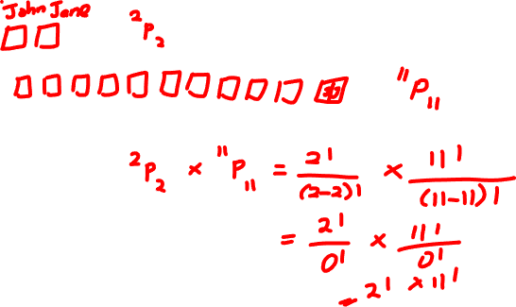
Twelve employees at a company picnic are to stand in a row for a group photograph. In how many ways can this be done if John and Jane
insist to stand next to each other?

Slide 16
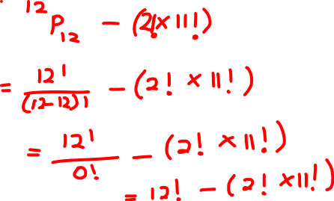
Twelve employees at a company picnic are to stand in a row for a group photograph. In how many ways can this be done if John and Jane
refuse to stand next to each other?

Slide 17
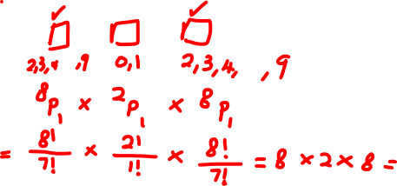
Example:
In a certain country, the telephone are codes are made up of three-digit numbers, where the first and third digits can neither be 0 nor 1, the second digit must be either 0 or 1. How many numbers of this type are possible?

Slide 18


Combination
To find the number of different ways to select $r$ objects from $n$ objects.
$${{}_{}^{n}C}_{r}=\frac{n!}{\left(n−r\right)!r!}$$

Slide 19
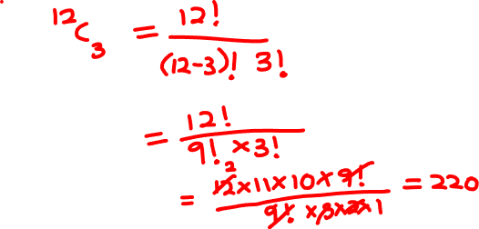
Example
How many different combinations of management can there be to fill the positions of president, vice-president and treasurer of a football club knowing that there are 12 eligible candidates?

Slide 20
Example
How many groups can be made from the word "house" if each group consists of 3 alphabets?

Slide 21
Example
Sarah has 8 colored pencils that are all unique. She wants to pick three colored pencils from her collection and give them to her younger sister. How many different combinations of colored pencils can Sarah make from 8 pencils?

Slide 22
Example
Alice has 6 chocolates. All of the chocolates are of different flavors. She wants to give two of her chocolates to her friend. How many different combinations of chocolates can Alice make from six chocolates?

Slide 23
Example:
In how many ways can HR committee select 3 out of 12 job applicant for further consideration?

Slide 24
Example:
Sammy’s Sandwich Shop offers a soup, sandwich and beverage combination at a special price. There are three types of sandwiches (turkey, tuna and tofu), two types of soups (minestrone and split pea) and three types of beverages (coffee, milk and mineral water) to choose from. Determine how many meal combinations are possible.

Slide 25
Example:
A man bought three vanilla ice cream cones, two chocolate cones, four strawberry cones and five butterscotch cones for his14 children. In how many ways can he distribute the cones among his children?

Slide 26
Question:
A class has twenty students, of which 12 are females and 8 are males. In how many ways can a committee of 5 be chosen if
no restriction is placed on the number of males or females on the committee?
no males are to be included on the committee?
the committee must have 3 females and 2 males?

Slide 27
Question:
A committee of 4 is to be elected from a group of 15people. How many different committees are possible if
there is no restriction between the responsibilities of the members?
one person is the chair and the rest are general members?
one person is the chair, one person is the secretary, one person is in charge of the refreshment and one person cleans up after the meetings?

Slide 28
Question:
200 people buy raffle tickets. 3 winning tickets will be drawn at random.
If the first prize is $100, the second prize is $50 and the third prize is $20, in how many different ways can the prizes be awarded?
If each prize is $50, in how many ways can the prizes be awarded?

Slide 29
Question 4
At a college library exhibition of faculty publications, 3 mathematics, 4 social sciences and 3 biology books are to be displayed on the shelf. In how many ways can these different books be arranged if
a. no restriction on the arrangement?
b. same subjects are placed together?

Slide 30
Question 5
A student sitting for an examination is required to answer 10 out of 15 questions. In how many ways can
a. these questions be selected?
b. the 10 questions be selected if exactly 2 out of first 3 questions must be answered?

